Slide 1
Carbonic anhydrase
Rehan shaikh d-20

Slide 2
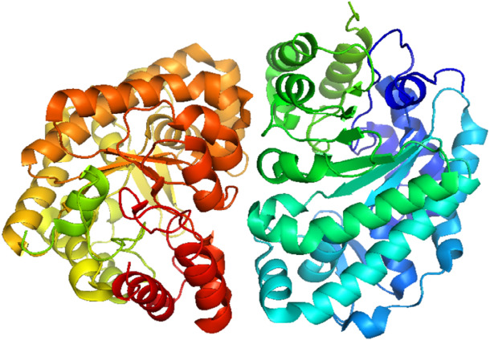
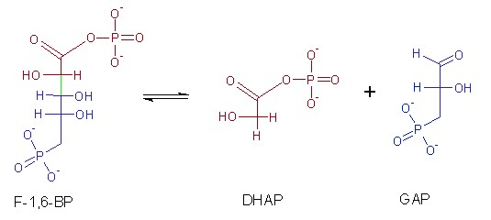
Lyases class
Lyases are a class of enzymes (EC 4) that catalyze the breaking of chemical bonds in substrates, other than by hydrolysis or oxidation
They play a key role in metabolic pathways, such as the citric acid cycle and amino acid metabolism.

Slide 3
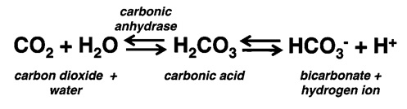
Carbonic anhydrase
Carbonic anhydrase is a zinc-containing enzyme of the lyase class (EC 4.2.1.1) that catalyzes the reversible hydration of carbon dioxide to carbonic acid. It plays a crucial role in physiological processes such as respiration, CO₂ transport, and pH regulation.
https://www.pharmacologyeducation.org/sites/default/files/Carb_anhydrase_reaction.jpg

Slide 4
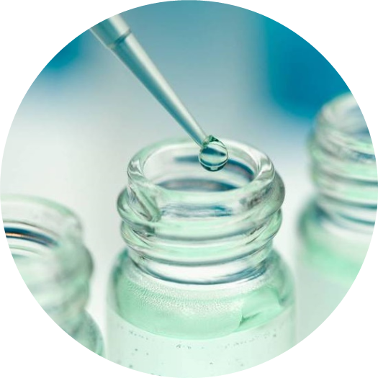
functions
Carbonic anhydrase is widely present in red blood cells, kidneys, and various tissues.
It helps in maintaining blood pH by rapidly converting CO₂ into bicarbonate and vice versa.
The enzyme is highly efficient, capable of catalyzing millions of reactions per second.
In medicine, its inhibitors are used to treat glaucoma, epilepsy, and fluid retention.
Industrially, it is applied in carbon capture technologies and CO₂ management processes.

Slide 5

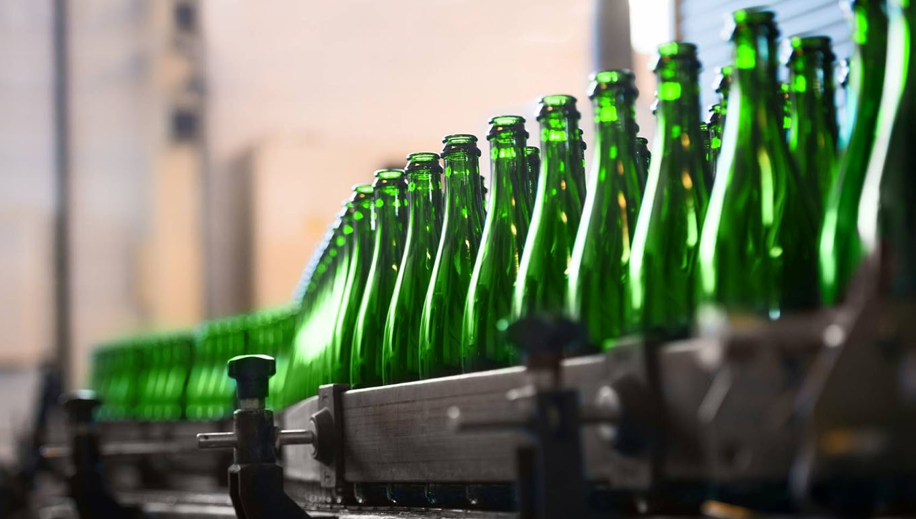
Industrial applications
-Beverage Industry – Improves efficiency in carbonating drinks and controlling CO₂ levels in beverages.
-Biocatalysis & Biosensors – Used in CO₂ sensors and enzyme-based systems for monitoring or chemical processes.
-Environmental Engineering – Helps in CO₂ sequestration and conversion into stable forms like bicarbonates or carbonates.
-Pharmaceutical Applications – Although indirect, engineered carbonic anhydrases are explored in drug delivery and medical devices related to CO₂/bicarbonate balance.
-Carbon Capture & Storage (CCS) – Speeds up the absorption of CO₂ from industrial flue gases into solutions, helping reduce greenhouse gas emissions.

Slide 6
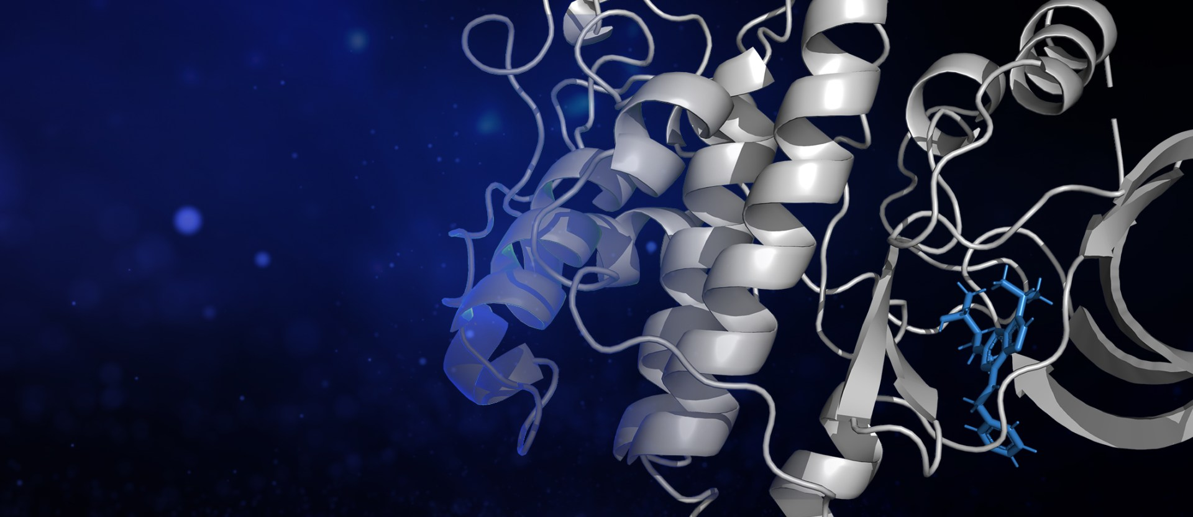


From the standpoint of an engineer
Develop software to simulate carbonic anhydrase kinetics, helping chemical/biochemical engineers optimize CO₂ capture systems. Visualize reaction dynamics under various industrial conditions to guide process design.
Develop computational tools for enzyme design, mutation analysis, and predicting the effects of changes on activity and stability. Collaborate with molecular biologists to suggest modifications that enhance industrial performance.
Use machine learning to predict enzyme behavior under different industrial conditions, improving efficiency and stability.Analyze large datasets from experiments to identify patterns and optimize enzyme performance

Slide 7
References
https://en.wikipedia.org/wiki/Carbonic_anhydrase
https://images.ctfassets.net/grb5fvwhwnyo/5jKbpb2iWQhnSGXeY4KRwg/3d56c7fe5e96e75d19fbfad95c5f0229/card-premiumization-in-beverage-industry.jpg
https://letstalkscience.ca/sites/default/files/2021-01/Robot_thinking.jpg
https://www.sciencedirect.com/topics/medicine-and-dentistry/carbonic-anhydrase
https://pmc.ncbi.nlm.nih.gov/articles/PMC6695913/
https://www.sciencedirect.com/science/article/pii/S0163725896001982
https://pdb101.rcsb.org/motm/49
https://www.britannica.com/science/carbonic-anhydrase
https://www.mpbio.com/us/carbonic-anhydrase?srsltid=AfmBOopaCen3q9wYGx1ZJHMvaj6f7rZewvlwQSz9-PbbyiKHDjoYYlSy

